Slide 1

Optimizing E-commerce sales strategies using customer data
Kazi Alimul Alam
ID: B01025571
Course: ECMM 6000 – Overview of Electronic Commerce
Instructor: Grant Sulivan

Slide 2


Introduction
Objective:
To explore how e-commerce businesses use customer data to optimize sales strategies.
Importance:
Data-driven insights improve customer engagement and drive sales.

Slide 3
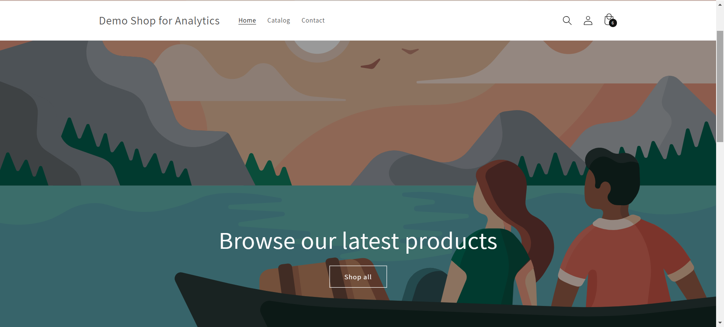
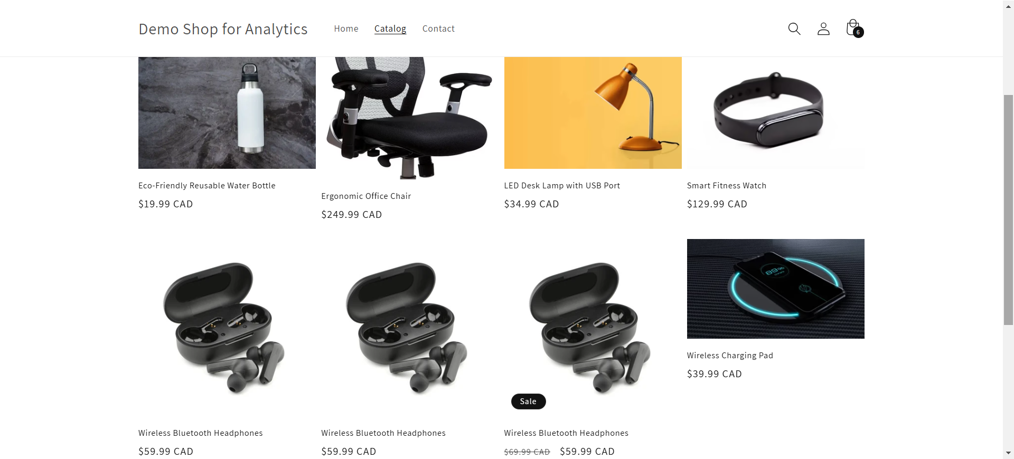
Methodology
Steps Taken:
Set up a Shopify store with sample products.
Integrated Google Analytics for data tracking.
Tools Used:
Shopify
Google Analytics
Shop Name: Demo Shop for Analytics
Link:
https://egm5vs-mk.myshopify.com/
Pswd: kazi

Slide 4

Key metrics
Traffic Sources
Active Users
Top Pages
User Engagements
Behavior Flow
Conversion rate

Slide 5
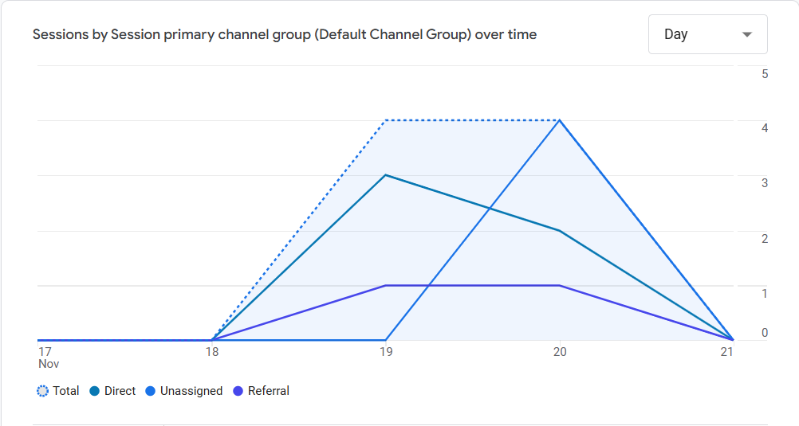
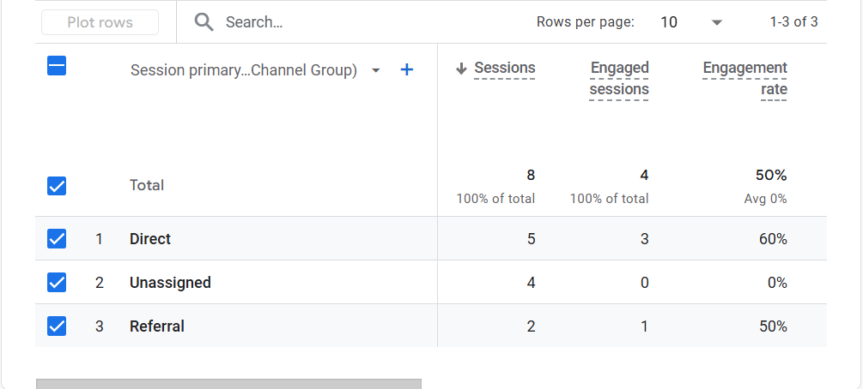
Traffic Sources:
Most of the traffic originates from direct sources, indicating effective initial outreach or loyal returning visitors. A smaller proportion comes from referral links and organic search. This suggests opportunities for further optimizing SEO and increasing partnerships to drive additional traffic.

Slide 6
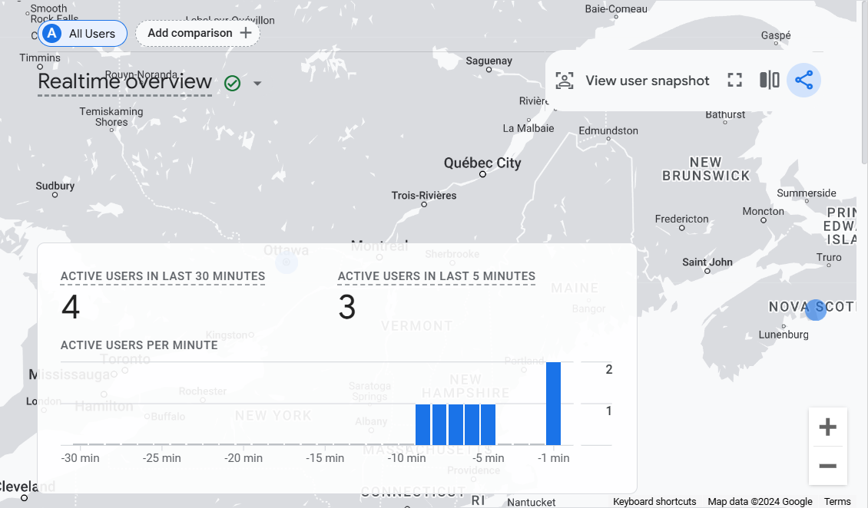
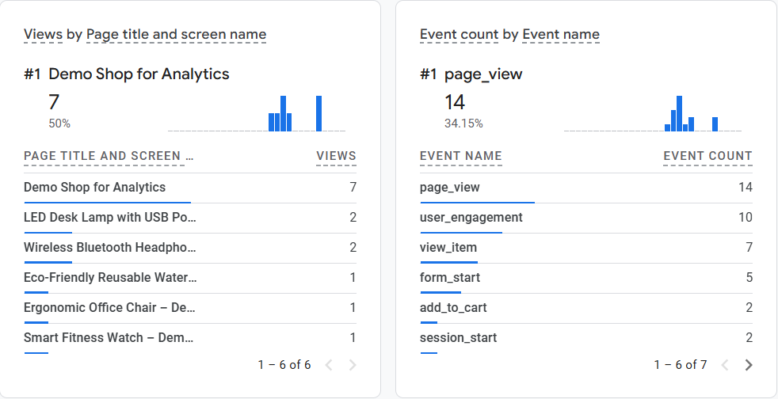
Active Users:
The data highlights fluctuations in active user counts, with peak activity occurring during specific campaigns or promotions. The overall trend shows consistent engagement, but there is potential for improvement during off-peak periods through targeted outreach.

Slide 7
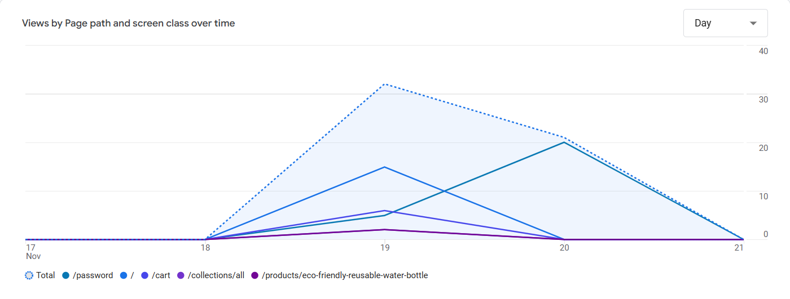
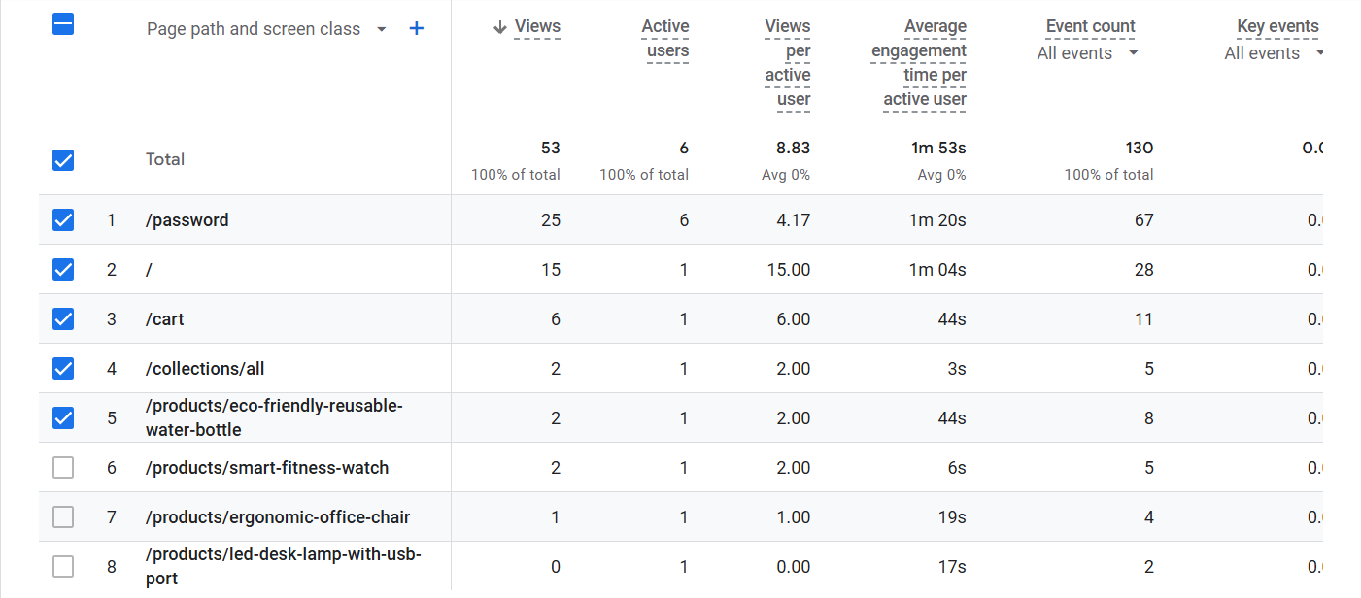
Top Pages:
The data highlights that the password page received the highest views (25) and the longest average engagement time (1m 20s), indicating repeated visits or users being restricted by the password-protected area.

Slide 8
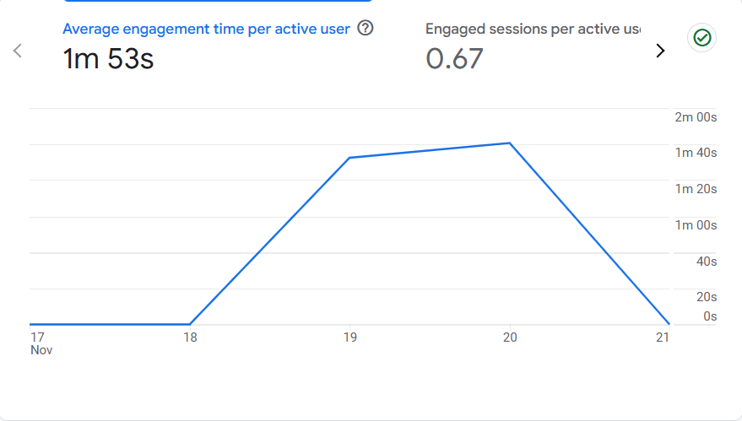
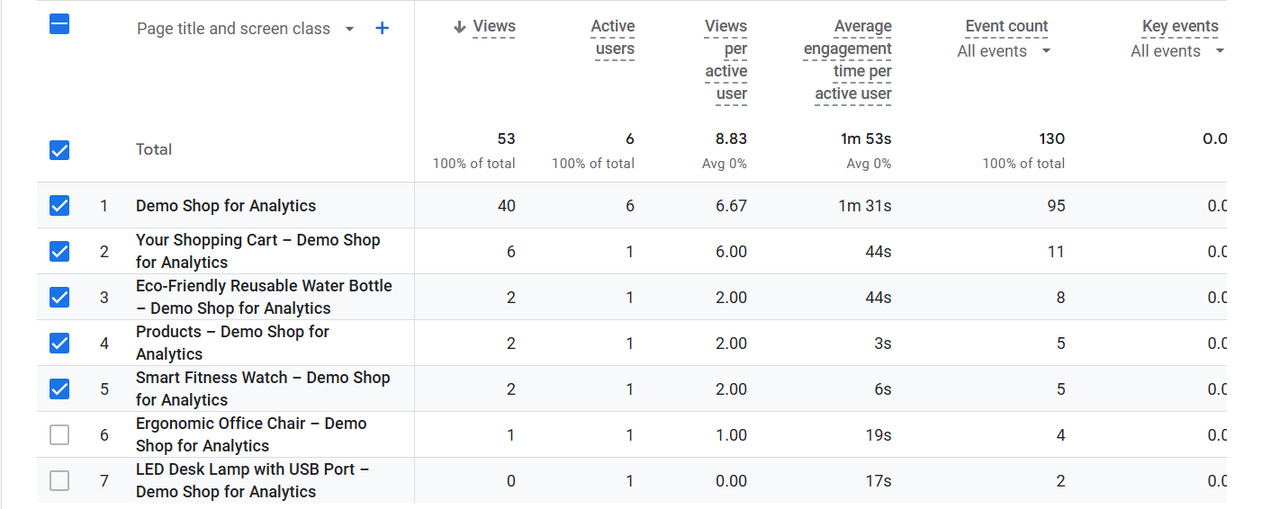
User Engagement:
Engagement metrics reveal that the password-protected page had the highest viewership and longest interaction time, while the cart page saw shorter engagement. This indicates a need to streamline user flow to encourage checkout completion.

Slide 9
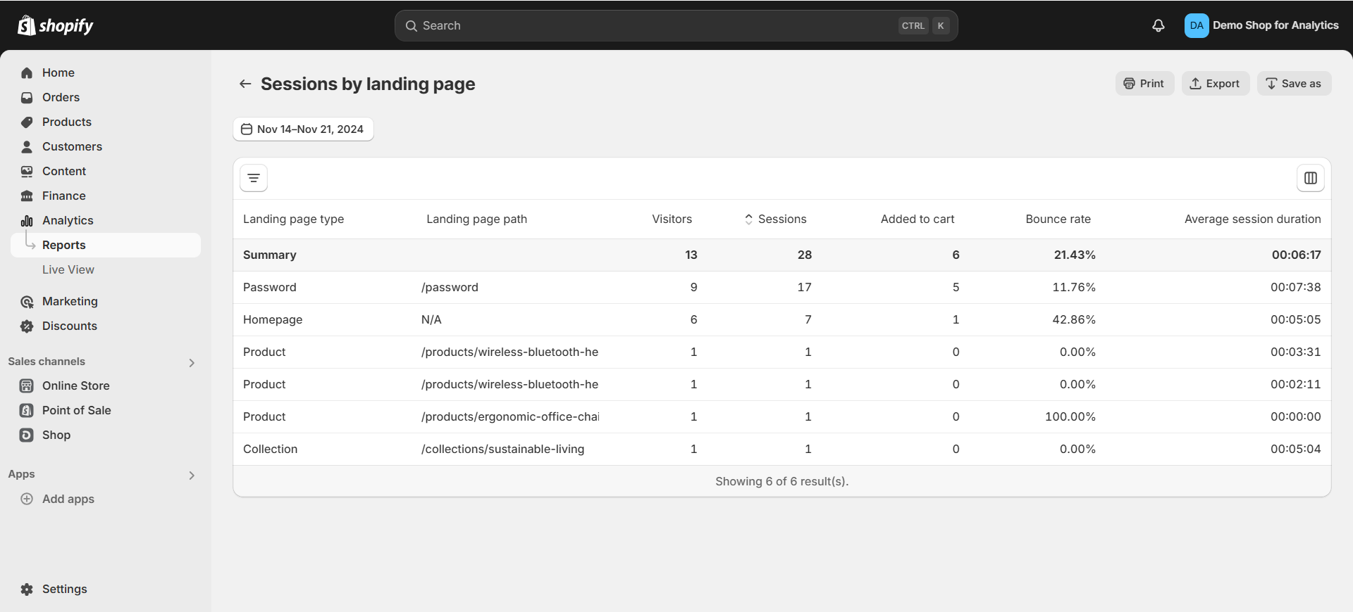
Behavior Flow:
Behavior flow analysis shows drop-offs primarily occurring between product browsing and adding items to the cart. Enhancing CTAs and simplifying navigation could significantly improve user retention and cart conversion rates.

Slide 10
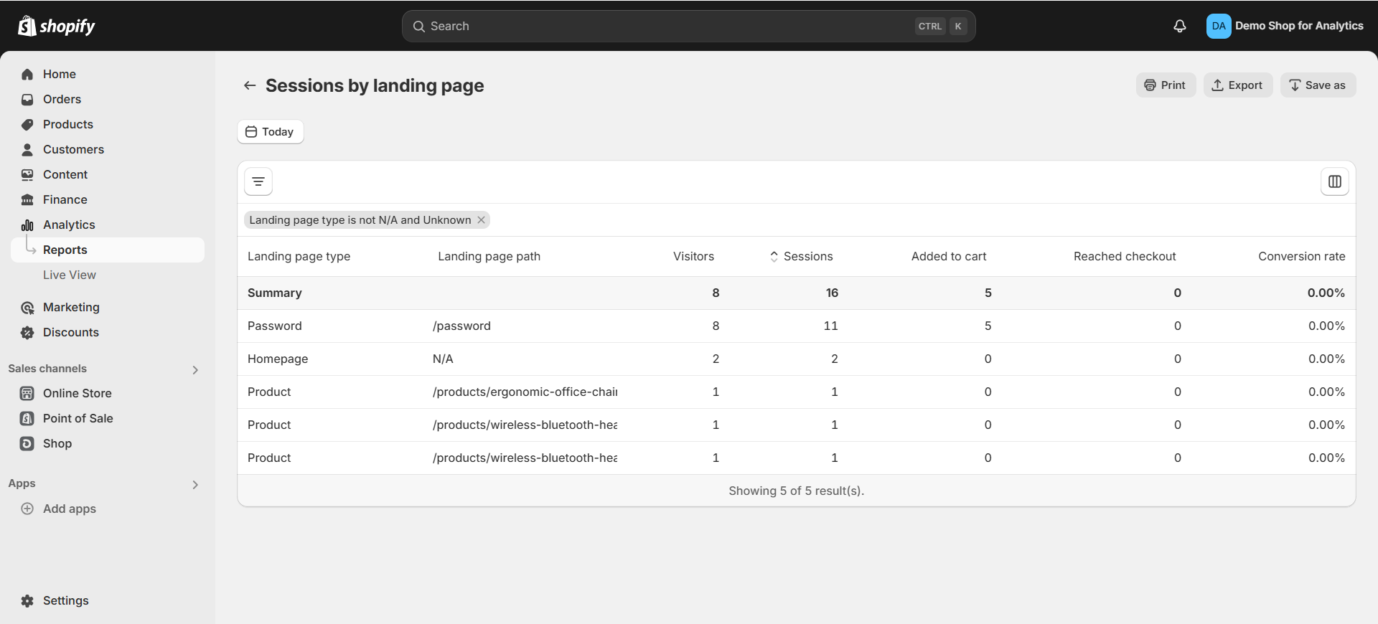
Conversion Rate:
The overall conversion rate remains low compared to industry standards, with the highest success observed for promotions featuring Wireless Bluetooth Headphones. Optimizing product descriptions, offering incentives, and simplifying the checkout process are recommended to increase conversions.

Slide 11

Findings
Traffic Sources:
Direct traffic dominates, while referral and unassigned traffic contribute minimally.
Engagement:
Direct traffic shows the highest engagement (60%), while unassigned sessions lack activity.
User Trends:
Active users are concentrated in Nova Scotia, with fluctuating engagement over time.
Session Behavior:
Significant drop-offs between browsing and checkout stages indicate friction in the user journey.

Slide 12

recommendations
Diversify Traffic: Use SEO and partnerships to increase referral traffic.
Enhance Engagement: Target active regions (e.g., Nova Scotia) with localized campaigns and interactive tools.
Optimize Pages: Simplify navigation and highlight CTAs to reduce drop-offs.
Boost Conversions: Streamline checkout and retarget unengaged users with ads or emails.
Utilize Real-Time Data: Leverage activity trends for timely promotions and insights.

Slide 13

conclusion
Summary of Insights:
Customer behavior data analysis highlights the need for improving navigation, traffic sources, and engagement strategies.
Emphasis on simplifying user experience to boost sales and retention rates.
Key Learning Outcomes:
The integration of Shopify and Google Analytics demonstrated actionable insights for e-commerce optimization.
Recommendations based on data can drive measurable improvements in user engagement and conversions.
Future Scope:
Regular monitoring of key metrics and iterative optimizations will ensure sustained growth and enhanced customer experience.

Slide 14
Sources
1) Demo Shop-Site for Analytics link-source
https://egm5vs-mk.myshopify.com/
2) Site generator web-source -
https://www.shopify.com
3) Data (related to shop-site) generating source –
https://developers.google.com › analytics
4) Product Source-
https://unsplash.com

Slide 15

Thank you

